Slide 1



GreenTech
Wealth Innovations
"Empowering a Sustainable Future with GreenTech Wealth Innovations"

Slide 2
GreenTech Wealth Innovations
CONTENT
MISSION
OUR PROCESS
PORTFOLIO
INTRODUCTION
CHOOSE MODEL
CODE
OUR TEAM
RESULTS
CONTACT US
CONTRIBUTION

Slide 3

GreenTech Wealth Innovations
Mission
"At GreenTech Wealth Innovations, our mission is to revolutionize trading through deep learning technology. We aim to empower investors with advanced algorithms that analyze market trends and optimize investment strategies, ensuring sustainable growth and wealth creation."
3

Slide 4




GreenTech Wealth Innovations
Our Team
QUALITY ASSURANCE MANAGER
PROJECT
MANAGER
PRODUCT
OWNER
MACHINE LEARNING
ENGINEER
5
Judith Beermann
Hassan Alrezeq
Kailash Padhiyar
Niko Matakheria

Slide 5
GreenTech Wealth Innovations
Introduction
CLIENT SITUATION
SCOPE OF PROJECT
METHODOLOGY
•Built a “Green” Robo Advisory based on the traditional mean-variance optimization
•Join premium segment
•Improve the existing model by using of AI (Machine Learning Algorithms)
•Using the Deep Learning for Trading
4

Slide 6
GreenTech Wealth Innovations
ETFs Information
Index | ETF | Ticker | Label
0 | iShares MSCI World SRI UCITS ETF EUR (Acc) | SUSW.MI | MSCI World SRI
1 | iShares MSCI Europe SRI UCITS ETF EUR (Acc) | IESE.AS | MSCI Europe SRI
2 | Lyxor Index Fund - Lyxor MSCI Future Mobility ESG Filtered (DR) UCITS ETF | ELCR.PA | MSCI Future Mobility ESG
3 | iShares € Green Bond UCITS ETF | GRON.F | Green Bonds
4 | iShares Global Clean Energy ETF | ICLN | Global Clean Energy
5 | iShares MSCI EM IMI ESG Screened UCITS ETF USD (Acc) | AYEM.DE | MSCI Emerging Markets ESG
6 | SPDR Dow Jones Global Real Estate ESG Fund | DJRE.AX | Global Real Estate ESG

Slide 7
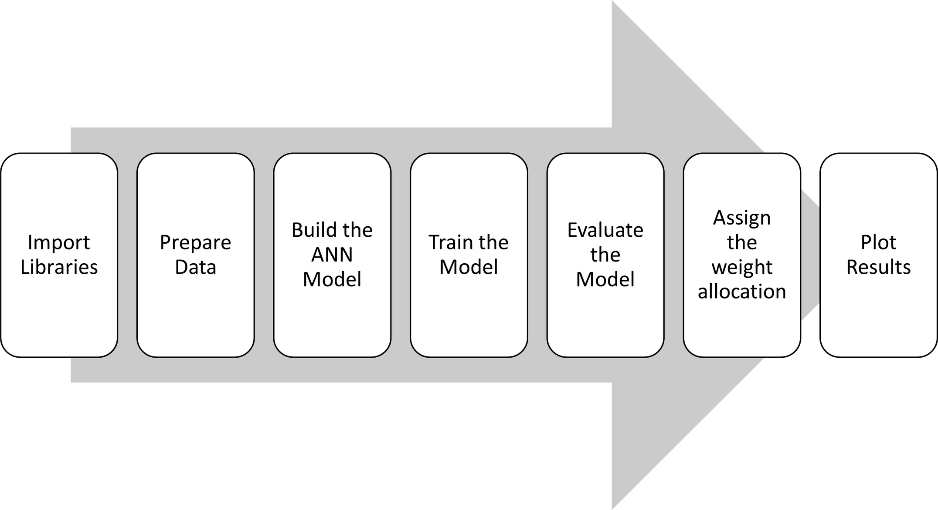
GreenTech Wealth Innovations
Our Process
8

Slide 8

GreenTech Wealth Innovations
Contribution
Data Acquisition, Data Exploration
Model Selection, Optimization & Quality assurance & Final Presentation
Team
Data Modelling, Model Training & testing, Assets Allocation, check accuracy
& Deployment
Kailash
Hassan
Data cleaning, implement optimal data cleaning, correlation analysis
& Graphics & visualization
Judith
Niko
7

Slide 9
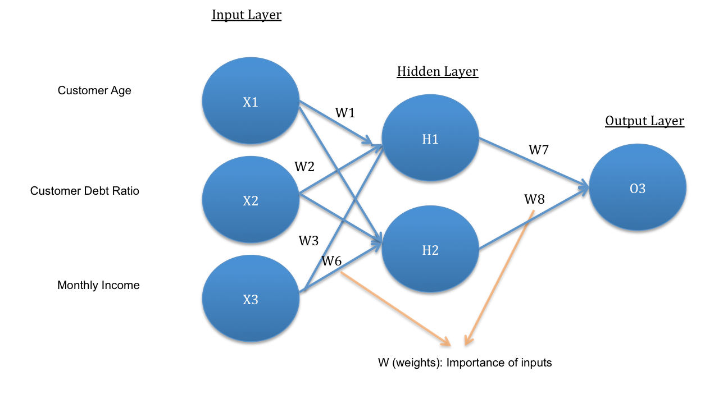
GreenTech Wealth Innovations
Model Selection
Artificial Neural Networks
(ANN) Model
ANNs can capture complex, non-linear relationships in data, which is common in financial markets where traditional linear models may fall short.
ANNs excel at recognizing patterns in historical data, making them suitable for forecasting future market movements based on past behavior.
9

Slide 10
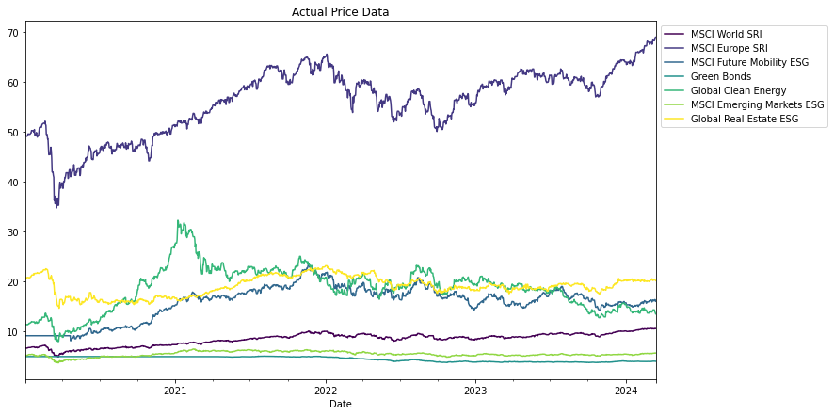
GreenTech Wealth Innovations
ETFs Actual Price
10

Slide 11
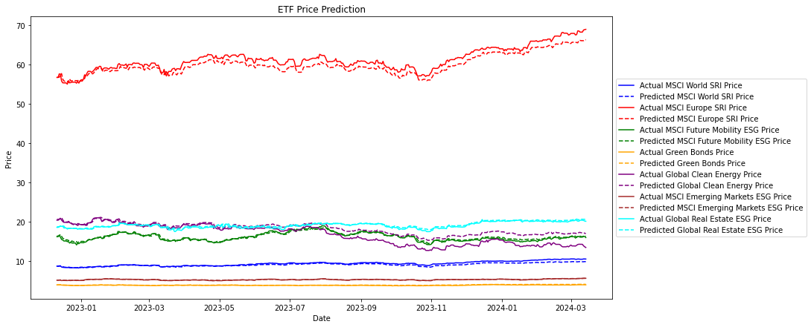
GreenTech Wealth Innovations
ETFs Price Predictions
11
Notes:
In the context of an artificial neural network (ANN), the numbers `128`, `64`, and `32` refer to the number of neurons (units) in the respective Dense layers. Here’s a breakdown of their roles and the potential impact of changing these numbers:
### Explanation of Dense Layer Parameters
1. **Dense(128, activation='relu')**:
- **128**: This is the number of neurons in the first hidden layer. Having more neurons allows the model to learn more complex patterns in the data. This layer will capture higher-dimensional representations of the input features.
- **activation='relu'**: The ReLU (Rectified Linear Unit) activation function helps in introducing non-linearity to the model, allowing it to learn more complex functions.
2. **Dense(64, activation='relu')**:
- **64**: This is the number of neurons in the second hidden layer. This layer refines the features learned from the previous layer, making the model more capable of capturing specific patterns.
- **activation='relu'**: Same as above, it introduces non-linearity.
3. **Dense(32, activation='relu')**:
- **32**: This is the number of neurons in the third hidden layer. By reducing the number of neurons, the network can focus on more specific and refined features.
- **activation='relu'**: Same as above.
4. **Dense(self.n)**:
- **self.n**: This is the number of neurons in the output layer, where `self.n` corresponds to the number of assets in the portfolio. Each neuron in the output layer represents the predicted value for one asset.
- No activation function specified: By default, a linear activation is used in the output layer, suitable for regression tasks where the outputs are continuous values.
### Impact of Changing the Number of Neurons
1. **Increasing the Number of Neurons**:
- **Pros**:
- More neurons can allow the model to capture more complex patterns and interactions in the data.
- Potentially better performance on training data due to higher capacity.
- **Cons**:
- Higher risk of overfitting, especially if the number of neurons is too high relative to the amount of training data.
- Increased computational cost and training time.
- Requires more memory.
2. **Decreasing the Number of Neurons**:
- **Pros**:
- Reduced risk of overfitting as the model has lower capacity and fewer parameters.
- Faster training time and reduced computational cost.
- Requires less memory.
- **Cons**:
- May not capture complex patterns in the data effectively.
- Potentially poorer performance if the model capacity is too low.
### Guidelines for Choosing the Number of Neurons
- **Experimentation**: The optimal number of neurons often requires experimentation and cross-validation. You might start with a smaller number of neurons and gradually increase them while monitoring the model's performance on validation data.
- **Domain Knowledge**: Leveraging domain knowledge can help in setting a reasonable starting point for the number of neurons.
- **Architecture Design**: Common practices include using a decreasing number of neurons in successive layers (as in the provided example with 128, 64, 32), which can help in gradually reducing the dimensionality of the learned features.
### Example Impact of Changing Numbers
- Changing the first layer from `Dense(128, activation='relu')` to `Dense(256, activation='relu')`:
- This would significantly increase the model's capacity to learn more complex patterns, but at the cost of increased training time and higher risk of overfitting.
- Changing the second layer from `Dense(64, activation='relu')` to `Dense(32, activation='relu')`:
- This reduces the capacity of the second layer, potentially making the model less capable of refining features learned from the first layer. This might help in regularization and preventing overfitting but could also lead to underfitting if the data is complex.
### Practical Advice
1. **Start Simple**: Begin with a relatively simple model (e.g., 32, 16, 8 neurons) and gradually increase complexity as needed.
2. **Use Validation**: Continuously monitor the model's performance on a validation set to find the optimal configuration.
3. **Regularization**: Incorporate techniques like dropout or L2 regularization to mitigate overfitting when using larger models.
4. **Automated Tuning**: Consider using automated hyperparameter tuning methods (like grid search or Bayesian optimization) to find the best configuration.
By understanding these principles, you can better design your ANN and adjust the number of neurons to balance between model complexity and performance.

Slide 12
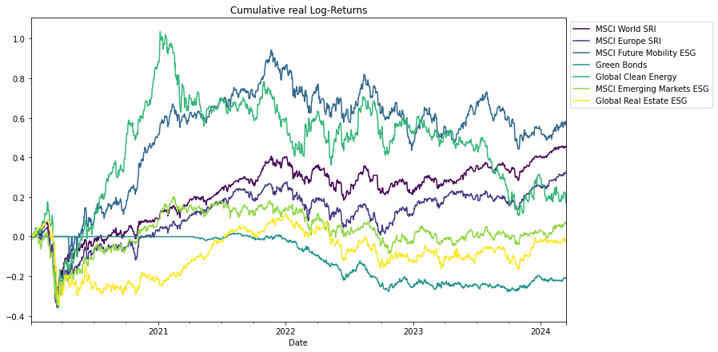
GreenTech Wealth Innovations
Cumulative Log-Returns
12

Slide 13
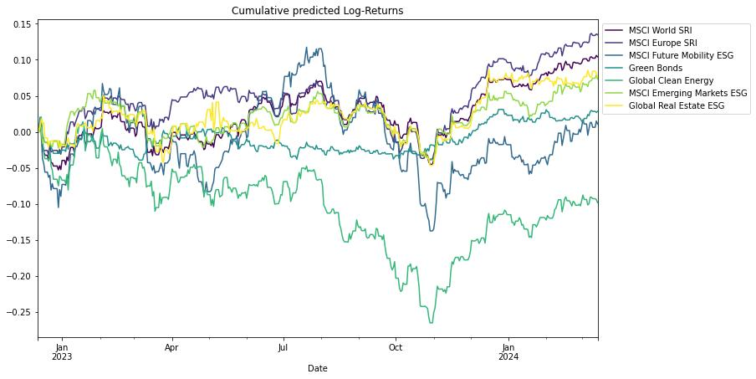
GreenTech Wealth Innovations
Cumulative Predicted
Log-Returns
13

Slide 14
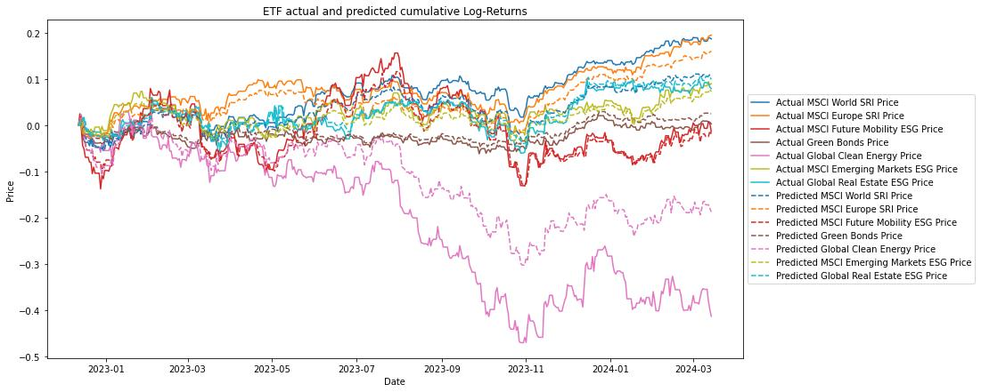
GreenTech Wealth Innovations
ETF Actual vs Predicted Returns
14

Slide 15
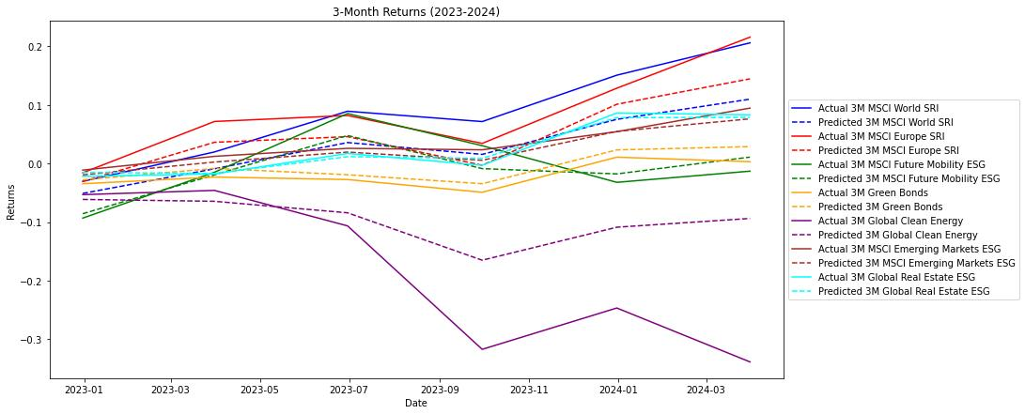
GreenTech Wealth Innovations
3 Months of Returns
15

Slide 16
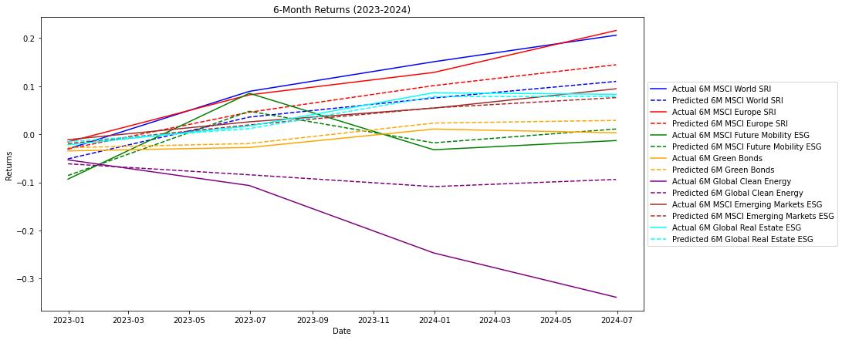
GreenTech Wealth Innovations
6 Months of Returns
16

Slide 17
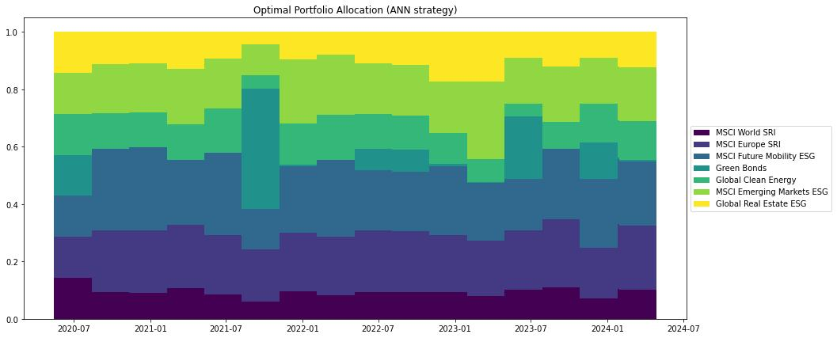
GreenTech Wealth Innovations
Optimal Portfolio Allocation
17

Slide 18
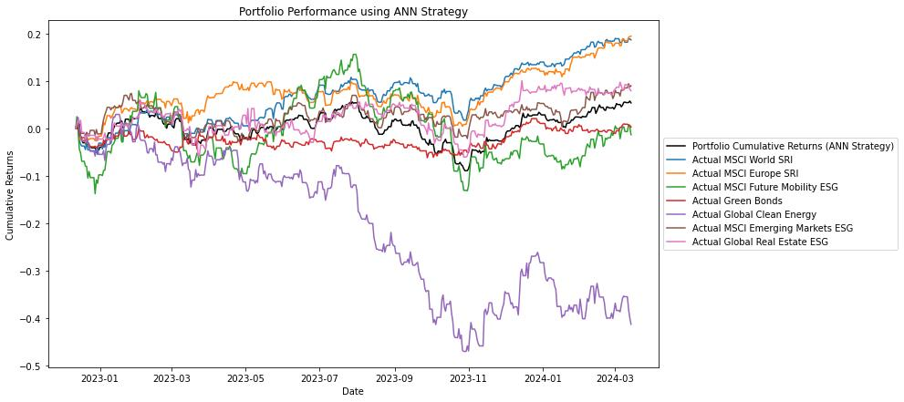
GreenTech Wealth Innovations
Portfolio Performance
using ANN
18

Slide 19
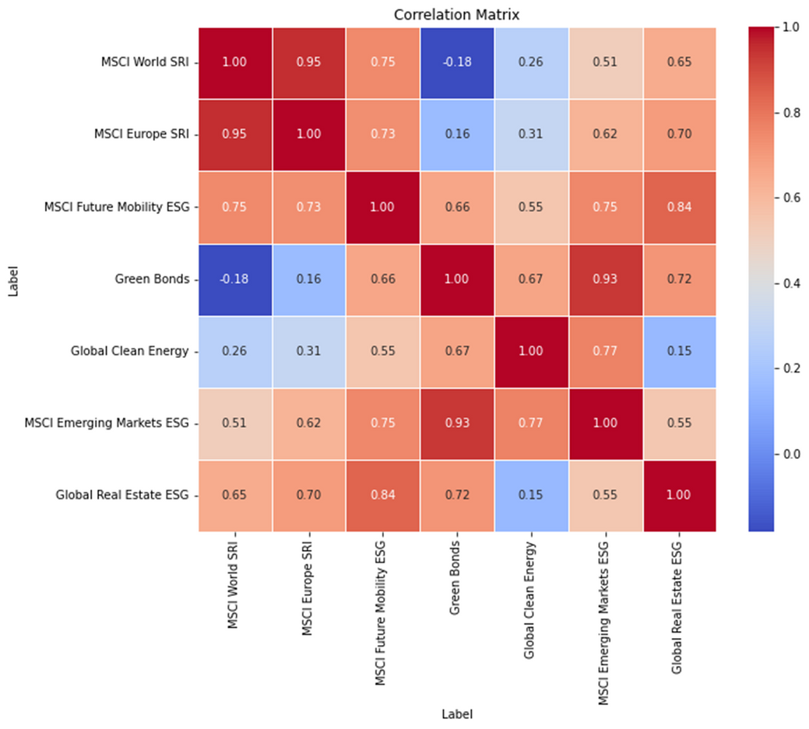
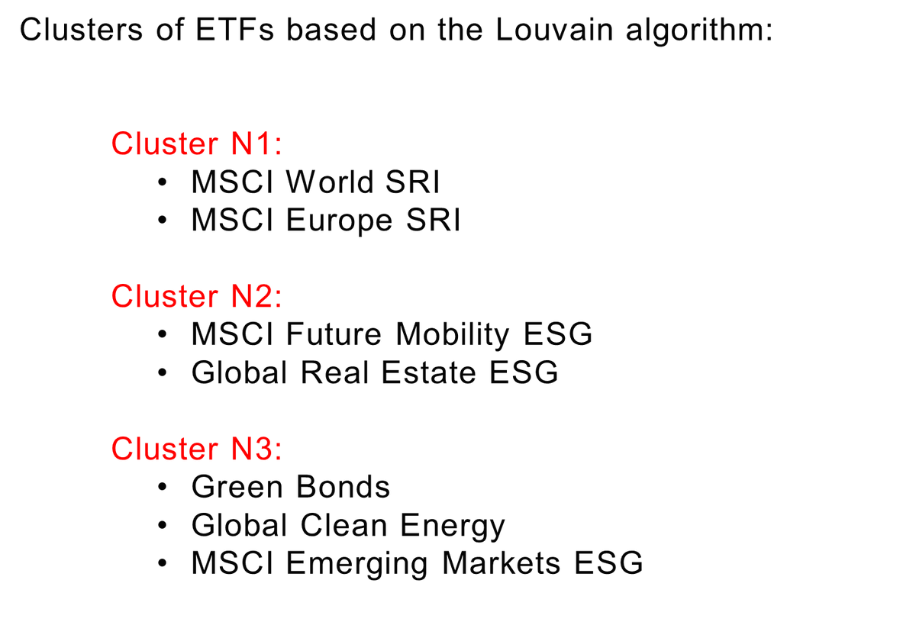
GreenTech Wealth Innovations
ETF Correlation Analysis
19

Slide 20

GreenTech Wealth Innovations
What improvements could be made?
Expand the dataset by adding more ETFs or lengthening the time period analyzed.
Test various neural network architectures to find the most effective one.
Develop a separate model specifically for predicting weight allocations.
Integrate correlation analysis into the existing model.
Embed risk management techniques directly into the model, like capping the maximum weights for individual ETFs.
Apply suitable metrics for evaluating weight allocations, such as the Sharpe ratio, portfolio variance, and turnover rate.
20

Slide 21
GreenTech Wealth Innovations
CODE TIME

Slide 22
GreenTech Wealth Innovations
THANK YOU
"Empowering a Sustainable Future with GreenTech Wealth Innovations"

